Slide 1
Predicting Fire Area with Machine Learning
By: Riley Neher, Akshay Srinivasan, and Amando Xu

Slide 2
Abstract
Forest fires and climate change:
Warmer, drier climate increases fire risk
800% growth in average annual area burned in Australia (past 32 years)
Over a billion animals perished in 2019-2020 bushfire season
Importance of accurate predictions:
Identify high-risk areas
Prevent or mitigate damage from wildfires
Crucial for preventing further climate change and wildfires
Machine learning models for prediction:
Regressions
Artificial Neural Networks
Decision Tree Model
Predicted fire-related variables:
Focus on estimated fire area as key outcome variable
Potential impact:
Preserve and protect Australian forest land

Slide 3
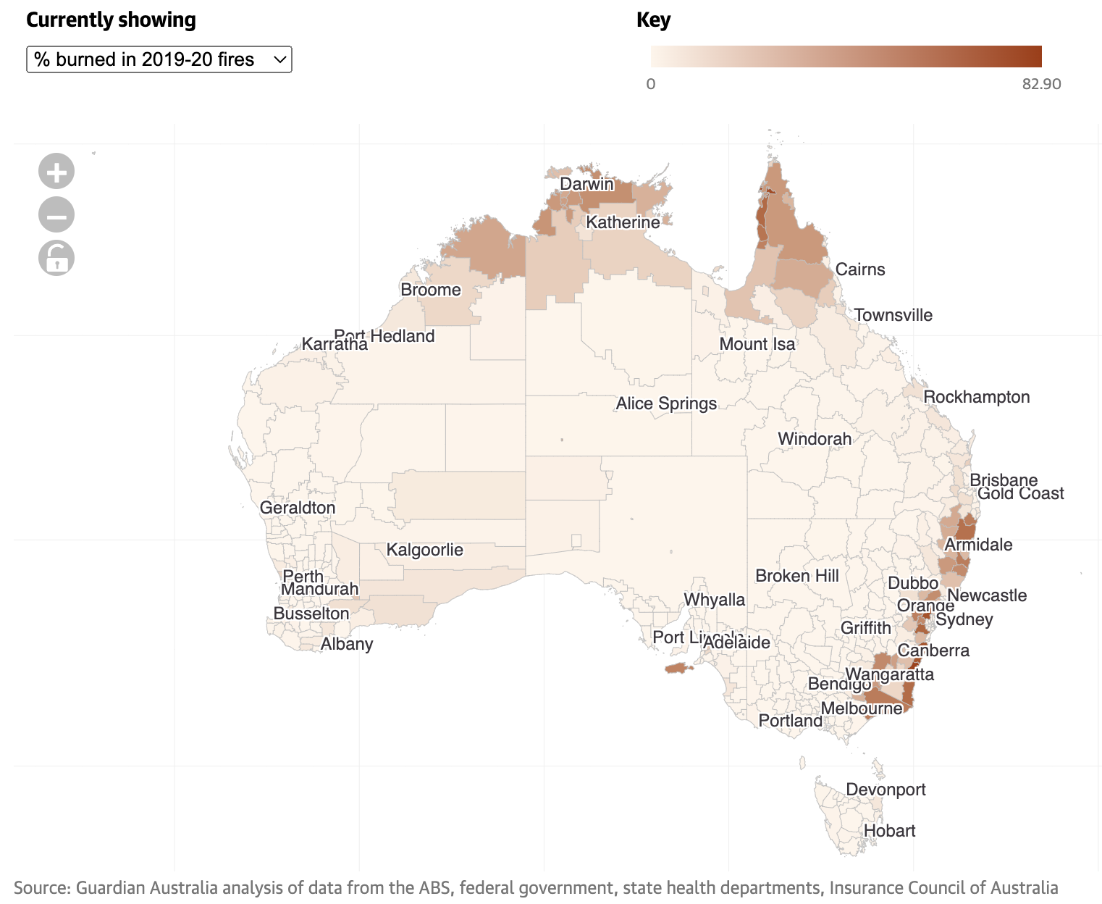
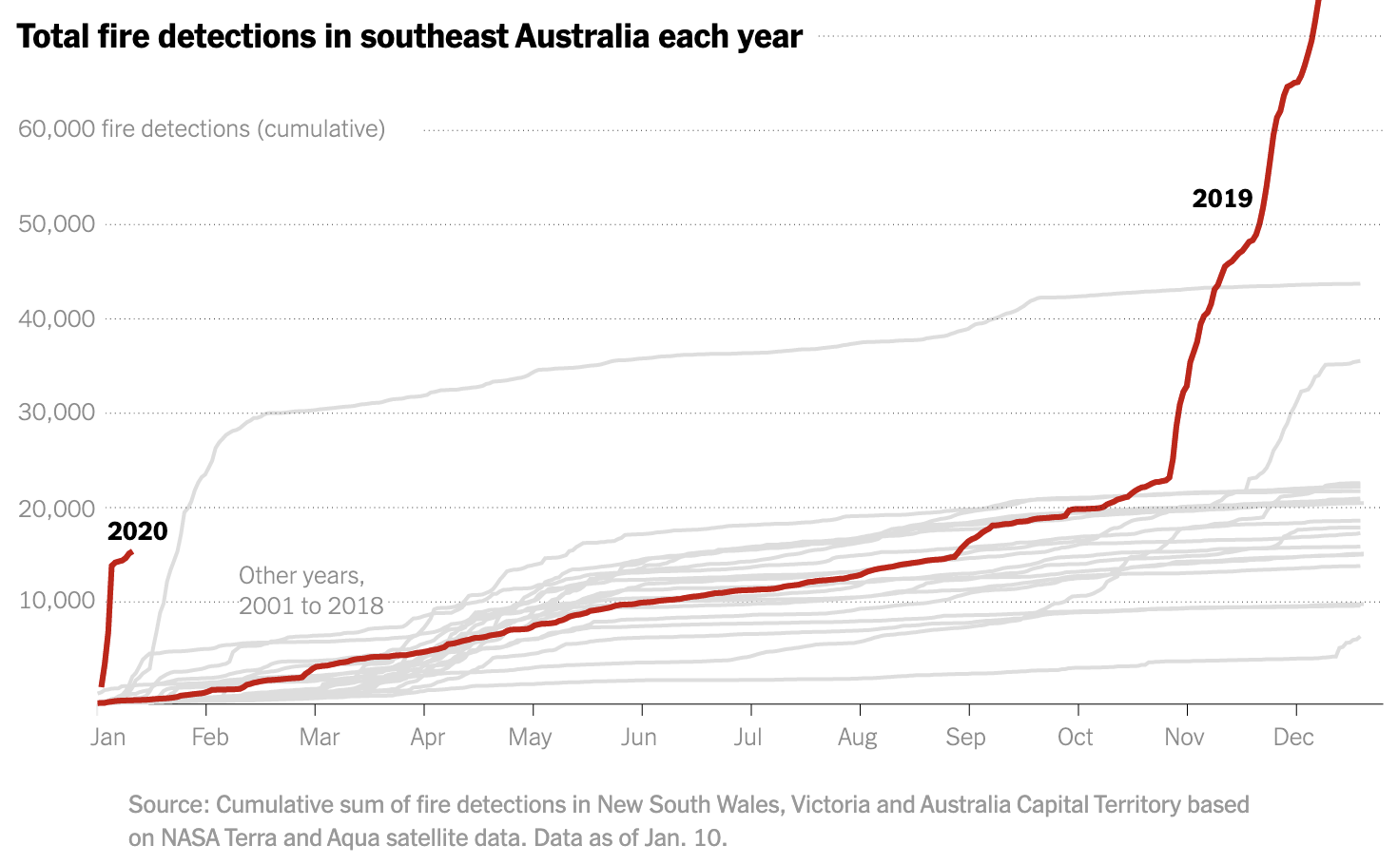
Introduction
Wildfires are characteristic of the Australian climate, however anthropogenic climate change has increased their frequency and power.
Most of the research about predicting wildfires has been concerned with predicting the presence of a fire given satellite imagery.
However, this method requires lots of data cleaning, interpolation, and extrapolation to feed into a model.
We intend to use weather statistics and climate features to predict various characteristics of the wildfire.

Slide 4
Data
Data source:
IBM's Spot Challenge for Wildfires - datathon competition
NASA satellite imagery processed through IBM PAIRS - Geoscope
Data categories:
Historical Weather Forecasts
Historical Weather
Vegetation Index
Land Class
Historical Wildfires
Divided into 7 states in Australia
Dataset features:
Min, max, mean, and variance values
Weather data: precipitation, humidity, soil water, solar radiation, temperature, wind speed
Land class data: vegetation types, urban, water bodies, open sea percentages
Weather forecast data: predictions and lead time
Fire data: fire area, brightness, radiative power, count (outcome variable)
Data cleaning process:
Pivoted rows into columns per dataset
Merged datasets into a combined dataset for analysis
Replaced missing data, especially lacking region or date information with region specific averages
Replaced missing weather forecasts with actual weather data

Slide 5
Data

Slide 6
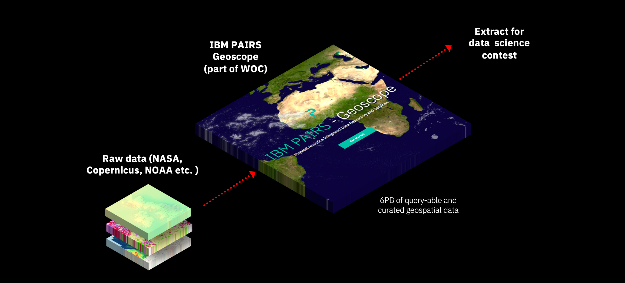
DATA SOURCE

Slide 7
Data Categories
Dataset Features
Historical Wildfires
Historical Weather
Historical Weather Forecast
Land Class
Normalized Vegetation Index
Divided into the 7 states of Australia
Min, max, mean, and variance values
Weather data: precipitation, humidity, soil water, solar radiation, temperature, wind speed
Land class data: vegetation types, urban, water bodies, open sea percentages
Weather forecast data: predictions and lead time
Fire data: fire area, brightness, radiative power, count (outcome variable)

Slide 8
Data Cleaning Process
Pivoted rows into columns per dataset
Merged datasets into a combined dataset for analysis
Replaced missing data, especially lacking region or date information with region specific averages
Replaced missing weather forecasts with actual weather data

Slide 9
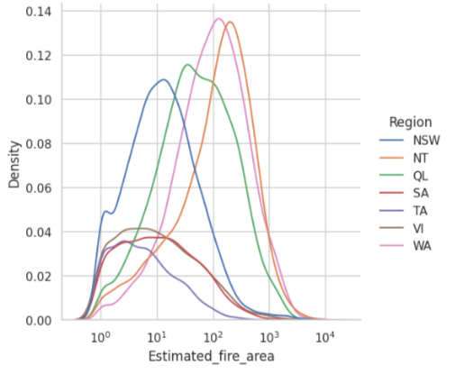
Distribution of Label (Estimated Fire Area)

Slide 10
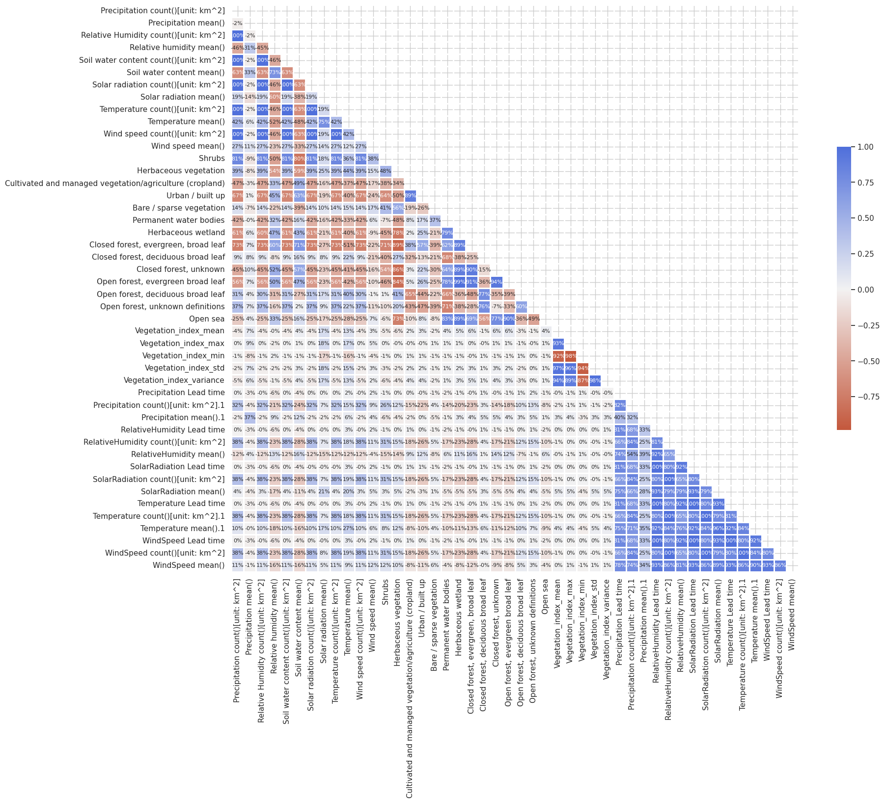
Pre-Processing through PCA for Multicollinear Data
Data had multicollinearity issues due to the nature of the features.
A correlation matrix was constructed to determine collinearity.
PCA was used to extract important information from the data and to reduce multicollinearity issues.
Aim was to capture above a certain threshold of variation in the data (95%).
Plot of explained variance with different component numbers showed that 9 components explained 95% of the variance.
For the rest of the models shown, data was pre-processed through PCA with 9 components.

Slide 11
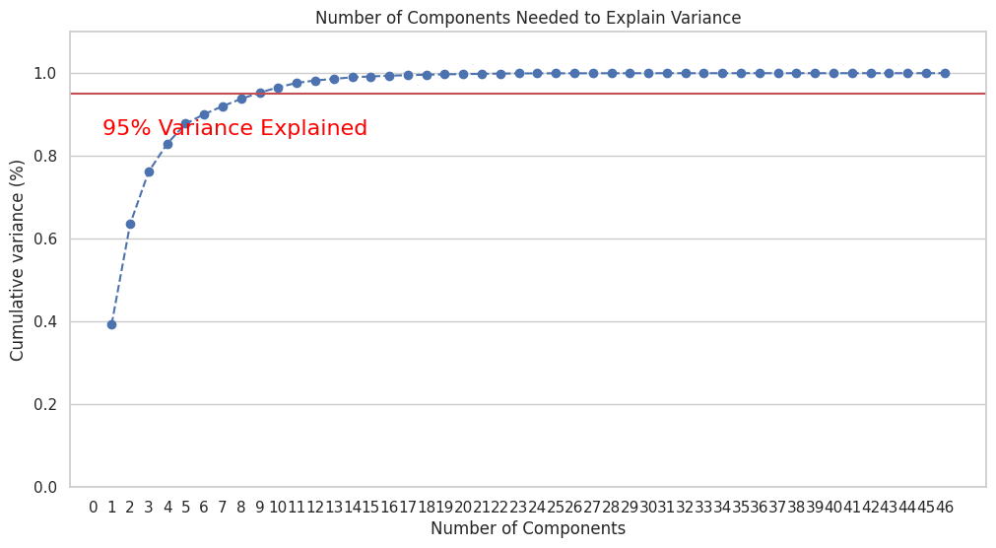

Slide 12
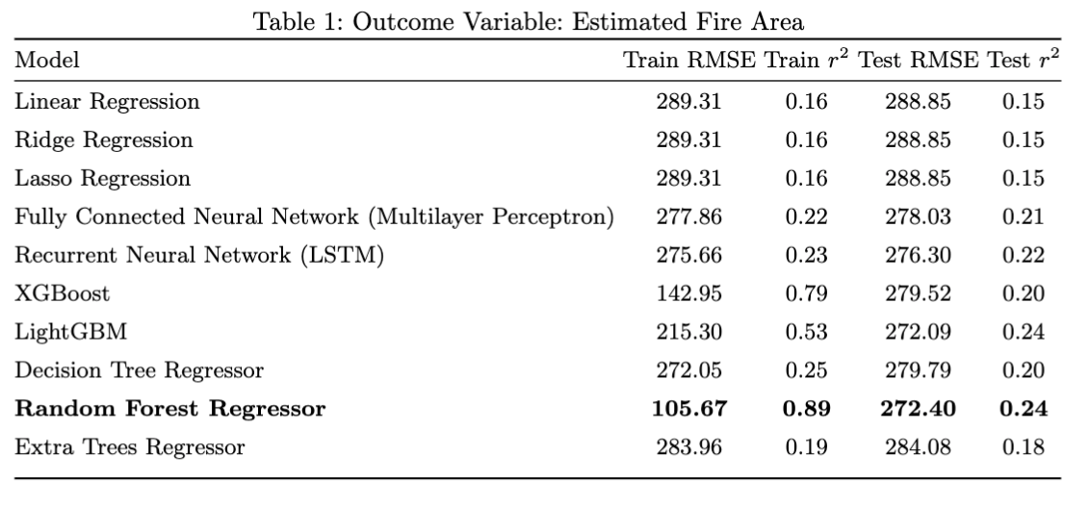
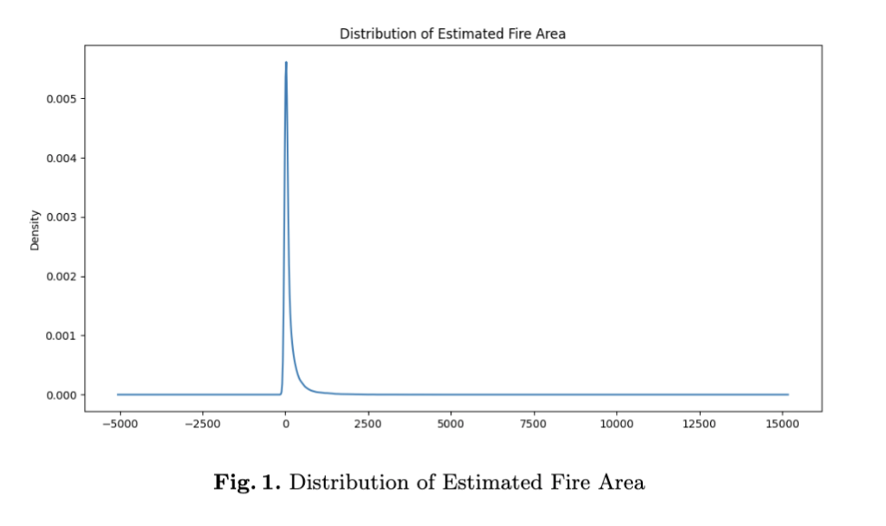
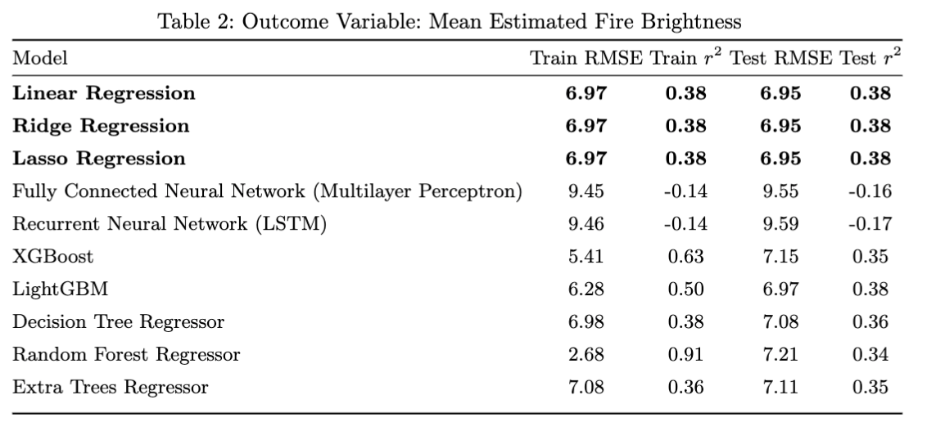
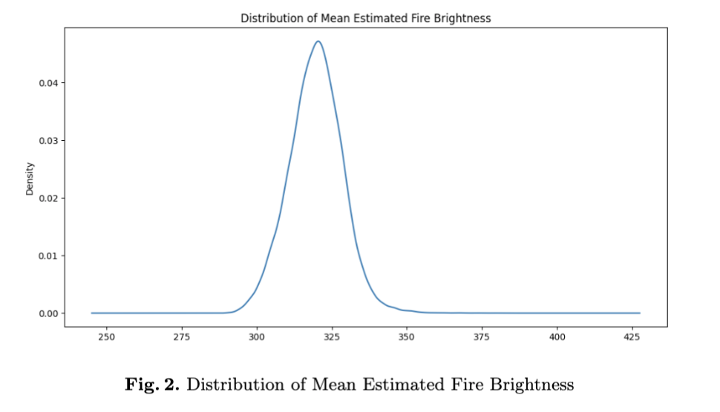

Slide 13
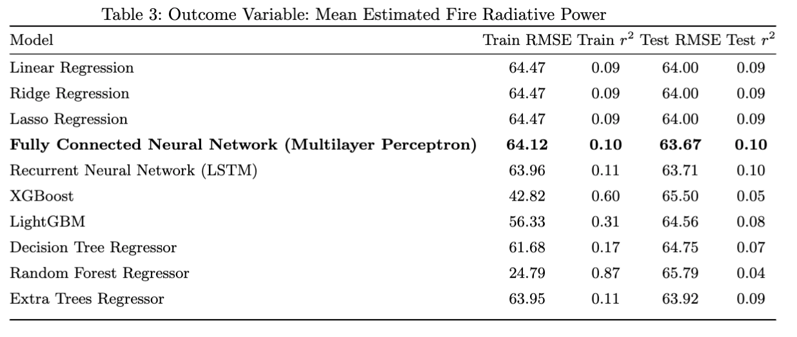
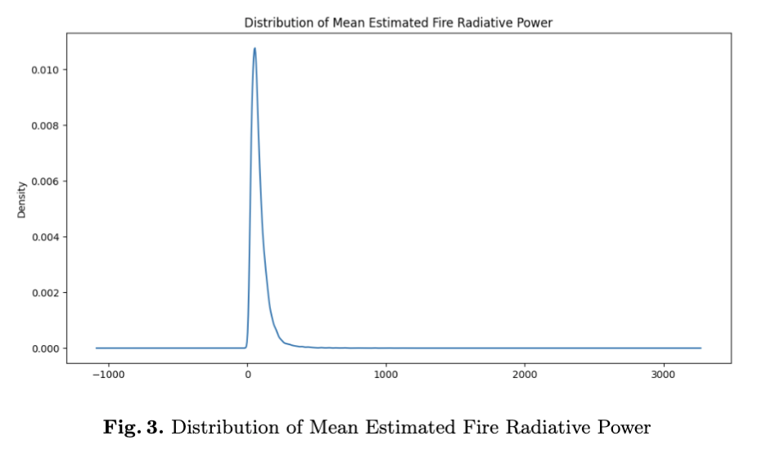
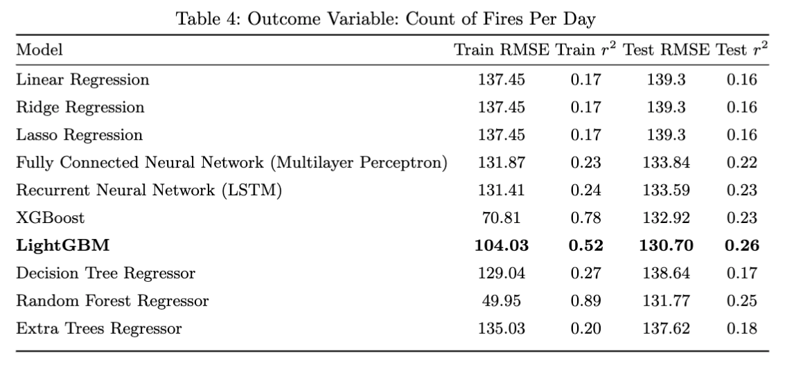
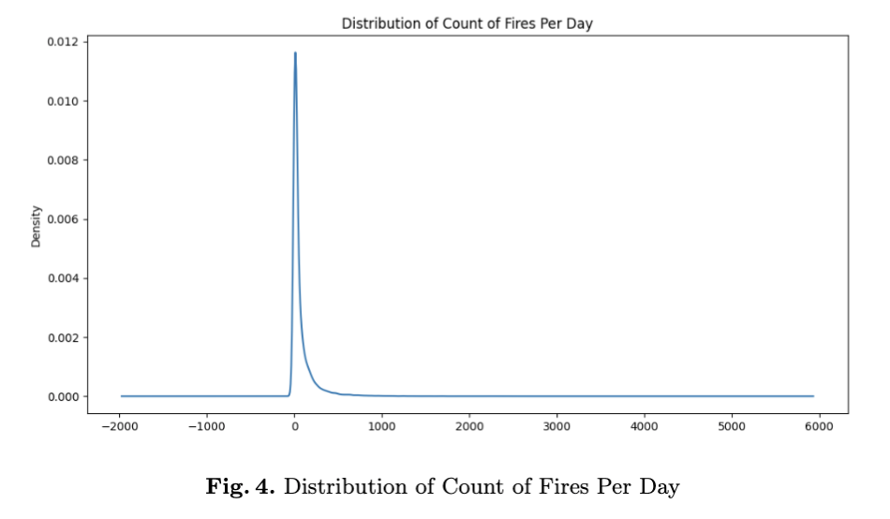

Slide 14
Discussion
Demonstrates that our best model is only able to predict 87-89% of the fire areas accurately
Soil water content, forecasted relative humidity and solar radiation means
Further data exploration and feature selection
Hyperparameter tuning
Related research
Victoria Bushfire predictions
Influence of human-induced climate change on forest fires

Slide 15
Questions

Slide 16
References
1. Hughes, L., Alexander, D. (2017). Climate change and the Victorian bushfire threat: Update 2017. Sydney: Climate Council of Australia.
2. Foley, M. “CSIRO Study Proves Climate Change Driving Australia’s 800% Boom in Bush-fires” The Sydney Morning Herald. 2021.
3. Kirchmeier-Young M.C et. al. “Attribution of the Influence of Human-Induced Climate Change on an Extreme Fire Season” Earth’s Future. vol. 7. no. 1. 2019.
4. Lewis, S. et. al. “Attribution of the Australian Bushfire Risk to Anthropogenic Climate Change” European Geosciences Union. vol. 21. no. 3. 2021.
5. Sayad, Y. et. al. “Predictive modeling of wildfires: A new dataset and machine learning approach” Fire Safety Journal. vol. 104. 2019.
6. Radke, D. et. al. “FireCast: Leveraging Deep Learning to Predict Wildfire Spread” The Twenty-Eighth International Joint Conference on Artificial Intelligence. 2019.
7. Hong, H. et. al. “Predicting spatial patterns of wildfire susceptibility in the Huichang County, China: An integrated model to analysis of landscape indicators” Ecological Indicators. Vol. 101. 2019.

